Slide 1
Normalization

Slide 2
What is Normalization?
Database designed based on the E-R model may have some amount of
  Inconsistency
  Uncertainty
  Redundancy
To eliminate these draw backs some refinement has to be done on the database.
  Refinement process is called Normalization
  Defined as a step-by-step process of decomposing a complex relation into a simple and stable data structure.
  The formal process that can be followed to achieve a good database design
  Also used to check that an existing design is of good quality
  The different stages of normalization are known as “normal forms”
  To accomplish normalization we need to understand the concept of Functional Dependencies.

Slide 3
Need for Normalization
Student_Course_Result Table
Student_Details |  |  | Course_Details |  |  |  | Result_Details
101 | Davis | 11/4/1986 | M4 | Applied Mathematics | Basic Mathematics | 7 | 11/11/2004 | 82 | A
102 | Daniel | 11/6/1987 | M4 | Applied Mathematics | Basic Mathematics | 7 | 11/11/2004 | 62 | C
101 | Davis | 11/4/1986 | H6 | American History |  | 4 | 11/22/2004 | 79 | B
103 | Sandra | 10/2/1988 | C3 | Bio Chemistry | Basic Chemistry | 11 | 11/16/2004 | 65 | B
104 | Evelyn | 2/22/1986 | B3 | Botany |  | 8 | 11/26/2004 | 77 | B
102 | Daniel | 11/6/1987 | P3 | Nuclear Physics | Basic Physics | 13 | 11/12/2004 | 68 | B
105 | Susan | 8/31/1985 | P3 | Nuclear Physics | Basic Physics | 13 | 11/12/2004 | 89 | A
103 | Sandra | 10/2/1988 | B4 | Zoology |  | 5 | 11/27/2004 | 54 | D
105 | Susan | 8/31/1985 | H6 | American History |  | 4 | 11/22/2004 | 87 | A
104 | Evelyn | 2/22/1986 | M4 | Applied Mathematics | Basic Mathematics | 7 | 11/11/2004 | 65 | B
Insert Anomaly
Delete Anomaly
Update Anomaly
Data Duplication

Slide 4
Functional dependency
In a given relation R, X and Y are attributes. Attribute Y is functionally dependent on attribute X if each value of X determines EXACTLY ONE value of Y, which is represented as X -> Y (X can be composite in nature).
We say here “x determines y” or “y is functionally dependent on x”
X→Y does not imply Y→X
If the value of an attribute “Marks” is known then the value of an attribute “Grade” is determined since Marks→ Grade
Types of functional dependencies:
  Full Functional dependency
  Partial Functional dependency
  Transitive dependency

Slide 5
Functional Dependencies
Consider the following Relation
REPORT (STUDENT#,COURSE#, CourseName, IName, Room#, Marks, Grade)
STUDENT# - Student Number
COURSE# - Course Number
CourseName - Course Name
IName - Name of the Instructor who delivered the course
Room# - Room number which is assigned to respective Instructor
Marks - Scored in Course COURSE# by Student STUDENT#
Grade - obtained by Student STUDENT# in Course COURSE#

Slide 6
Functional Dependencies- From the previous example
STUDENT# COURSE# → Marks
COURSE# → CourseName,
COURSE# → IName (Assuming one course is taught by one and only one Instructor)
IName → Room# (Assuming each Instructor has his/her own and non-shared room)
Marks → Grade

Slide 7
Dependency diagram
Report( S#,C#,SName,CTitle,LName,Room#,Marks,Grade)
S# → SName
C# → CTitle,
C# → LName
LName → Room#
C# → Room#
S# C# → Marks
Marks → Grade
S# C# → Grade
S#
C#
CTitle
SName
LName
Marks
Grade
Room#
Assumptions:
Each course has only one lecturer and each lecturer has a room.
Grade is determined from Marks.

Slide 8
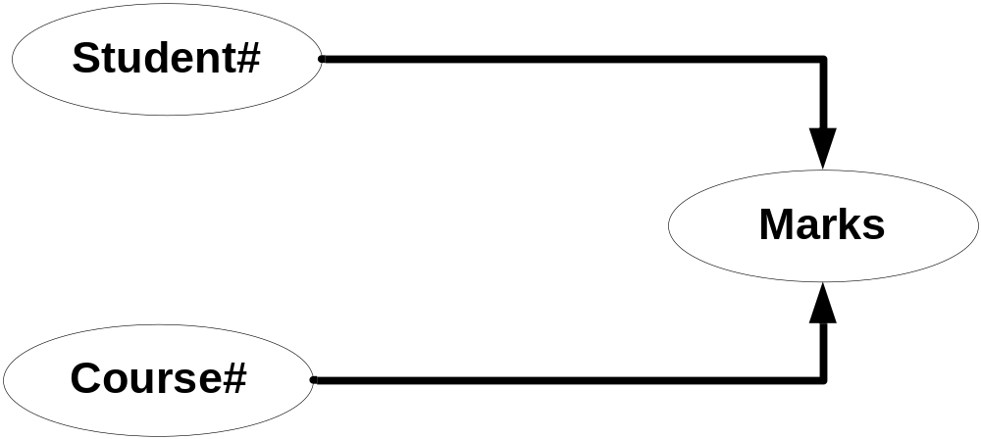
Full dependencies
X and Y are attributes.
X Functionally determines Y
Note: Subset of X should not functionally determine Y
Notes:
In above example Marks is fully functionally dependent on STUDENT# COURSE# and not on sub set of STUDENT# COURSE#. This means Marks can not be determined either by STUDENT# OR COURSE# alone. It can be determined only using STUDENT# AND COURSE# together. Hence Marks is fully functionally dependent on STUDENT# COURSE#.
CourseName is not fully functionally dependent on STUDENT# COURSE# because subset of STUDENT# COURSE# i.e only COURSE# determines the CourseName and STUDENT# does not have any role in deciding CourseName. Hence CourseName is not fully functionally dependent on STUDENT# COURSE#.

Slide 9
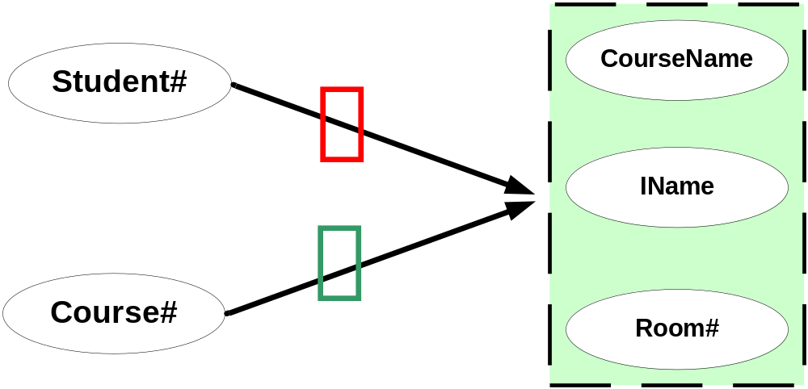
Partial dependencies
X and Y are attributes.
Attribute Y is partially dependent on the attribute X only if it is dependent on a sub-set of attribute X.
Notes:
In the above relationship CourseName, IName, Room# are partially dependent on composite attributes STUDENT# COURSE# because COURSE# alone defines the CourseName, IName, Room#.

Slide 10

Transitive dependencies
X Y and Z are three attributes.
X -> Y
Y-> Z
=> X -> Z
Notes:
In above example, Room# depends on IName and in turn IName depends on COURSE#. Hence Room# transitively depends on COURSE#.
Similarly Grade depends on Marks, in turn Marks depends on STUDENT# COURSE# hence Grade depends Fully transitively on STUDENT# COURSE#.
Transitive: Indirect

Slide 11
First normal form: 1NF
A relation schema is in 1NF :
  if and only if all the attributes of the relation R are atomic in nature.
  Atomic: the smallest level to which data may be broken down and remain meaningful
Notes:
In relational database design it is not practically possible to have a table which is not in 1NF.

Slide 12
Student_Course_Result Table
Student_Details |  |  | Course_Details |  |  |  | Results
101 | Davis | 11/4/1986 | M4 | Applied Mathematics | Basic Mathematics | 7 | 11/11/2004 | 82 | A
102 | Daniel | 11/6/1987 | M4 | Applied Mathematics | Basic Mathematics | 7 | 11/11/2004 | 62 | C
101 | Davis | 11/4/1986 | H6 | American History |  | 4 | 11/22/2004 | 79 | B
103 | Sandra | 10/2/1988 | C3 | Bio Chemistry | Basic Chemistry | 11 | 11/16/2004 | 65 | B
104 | Evelyn | 2/22/1986 | B3 | Botany |  | 8 | 11/26/2004 | 77 | B
102 | Daniel | 11/6/1987 | P3 | Nuclear Physics | Basic Physics | 13 | 11/12/2004 | 68 | B
105 | Susan | 8/31/1985 | P3 | Nuclear Physics | Basic Physics | 13 | 11/12/2004 | 89 | A
103 | Sandra | 10/2/1988 | B4 | Zoology |  | 5 | 11/27/2004 | 54 | D
105 | Susan | 8/31/1985 | H6 | American History |  | 4 | 11/22/2004 | 87 | A
104 | Evelyn | 2/22/1986 | M4 | Applied Mathematics | Basic Mathematics | 7 | 11/11/2004 | 65 | B

Slide 13
Table in 1NF
Student_Course_Result Table
Student# | Student Name | Dateof Birth | Course# | CourseName | Pre Requisite | Duration InDays | DateOf Exam | Marks | Grade
101 | Davis | 04-Nov-1986 | M4 | Applied Mathematics | Basic Mathematics | 7 | 11-Nov-2004 | 82 | A
102 | Daniel | 06-Nov-1986 | M4 | Applied Mathematics | Basic Mathematics | 7 | 11-Nov-2004 | 62 | C
101 | Davis | 04-Nov-1986 | H6 | American History |  | 4 | 22-Nov-2004 | 79 | B
103 | Sandra | 02-Oct-1988 | C3 | Bio Chemistry | Basic Chemistry | 11 | 16-Nov-2004 | 65 | B
104 | Evelyn | 22-Feb-1986 | B3 | Botany |  | 8 | 26-Nov-2004 | 77 | B
102 | Daniel | 06-Nov-1986 | P3 | Nuclear Physics | Basic Physics | 13 | 12-Nov-2004 | 68 | B
105 | Susan | 31-Aug-1985 | P3 | Nuclear Physics | Basic Physics | 13 | 12-Nov-2004 | 89 | A
103 | Sandra | 02-Oct-1988 | B4 | Zoology |  | 5 | 27-Nov-2004 | 54 | D
105 | Susan | 31-Aug-1985 | H6 | American History |  | 4 | 22-Nov-2004 | 87 | A
104 | Evelyn | 22-Feb-1986 | M4 | Applied Mathematics | Basic Mathematics | 7 | 11-Nov-2004 | 65 | B

Slide 14
Second normal form: 2NF
A Relation is said to be in Second Normal Form if and only if :
  It is in the First normal form, and
  No partial dependency exists between non-key attributes and key attributes.
An attribute of a relation R that belongs to any key of R is said to be a prime attribute and that which doesn’t is a non-prime attribute
To make a table 2NF compliant, we have to remove all the partial dependencies
  Note : - All partial dependencies are eliminated

Slide 15
Prime Vs Non-Prime Attributes
An attribute of a relation R that belongs to any key of R is said to be a prime attribute and that which doesn’t is a non-prime attribute
Report(S#,C#,StudentName,DateOfBirth,CourseName,PreRequisite,DurationInDays,DateOfExam,Marks,Grade)
Student #
Is a PRIME Attribute
Course #
Student Name
Date of Birth
CourseName
Prerequisite
Is NON-PRIME Attribute
Marks
Grade
DurationInDays
DateOfExam

Slide 16
Second Normal Form
STUDENT# is key attribute for Student,
COURSE# is key attribute for Course
STUDENT# COURSE# together form the composite key attributes for Results relationship.
Other attributes like StudentName (Student Name), DateofBirth, CourseName, PreRequisite, DurationInDays, DateofExam, Marks and Grade are non-key attributes.
To make this table 2NF compliant, we have to remove all the partial
dependencies.
Student #, Course# -> Marks, Grade
Student# -> StudentName, DOB,
Course# -> CourseName, Prerequiste, DurationInDays
Course# -> Date of Exam

Slide 17
Second Normal Form
Fully Functionally dependent on composite Candidate key
S#,C#
Marks
S#,C#
Grade
S#
StudentName
Partial Dependency
S#
DOB
C#
CourseName
C#
Prerequisite
Partial Dependency
C#
Duration
C#
DateOfExam
Partial Dependency

Slide 18
Second Normal Form - Tables in 2 NF
STUDENT TABLE
Student# | StudentName | DateofBirth
101 | Davis | 04-Nov-1986
102 | Daniel | 06-Nov-1987
103 | Sandra | 02-Oct-1988
104 | Evelyn | 22-Feb-1986
105 | Susan | 31-Aug-1985
106 | Mike | 04-Feb-1987
107 | Juliet | 09-Nov-1986
108 | Tom | 07-Oct-1986
109 | Catherine | 06-Jun-1984
COURSE TABLE
Course# | Course Name | Pre Requisite | Duration InDays
M1 | Basic Mathematics |  | 11
M4 | Applied Mathematics | M1 | 7
H6 | American History |  | 4
C1 | Basic Chemistry |  | 5
C3 | Bio Chemistry | C1 | 11
B3 | Botany |  | 8
P1 | Basic Physics |  | 8
P3 | Nuclear Physics | P1 | 13
B4 | Zoology |  | 5
Notes:
Let us re-visit our 1NF table structure.
STUDENT# is key attribute for Student,
COURSE# is key attribute for Course
STUDENT# COURSE# together form the composite key attributes for Results relationship.
Other attributes like StudentName (Student Name), DateofBirth, CourseName, PreRequisite, DurationInDays, DateofExam, Marks and Grade are non-key attributes.
To make this table 2NF compliant, we have to remove all the partial dependencies.
StudentName, DateofBirth, Address depends only on STUDENT#
CourseName, PreRequisite, DurationInDays depends only on COURSE#
DateofExam depends only on COURSE#
Marks and Grade depends on STUDENT# COURSE#
To remove this partial dependency we can create four separate tables, Student, Course and Result Exam_Date tables as shown below.
In the first table (STUDENT), the key attribute is STUDENT# and all other non-key attributes are fully functionally dependant on the key attributes.
In the second table (COURSE), COURSE# is the key attribute and all the non-key attributes are fully functionally dependant on the key attributes.
In third table (Result) STUDENT# COURSE# together are key attributes and all other non key attributes Marks and Grade fully functionally dependant on the key attributes.
In the fourth table (Exam_Date), DateOfExam depends only on Course#.
These four tables also are compliant with First Normal Form definition. Hence these four tables are in Second Normal Form (2NF).

Slide 19
Second Normal form – Tables in 2 NF
Student# | Course# | Marks | Grade
101 | M4 | 82 | A
102 | M4 | 62 | C
101 | H6 | 79 | B
103 | C3 | 65 | B
104 | B3 | 77 | B
102 | P3 | 68 | B
105 | P3 | 89 | A
103 | B4 | 54 | D
105 | H6 | 87 | A
104 | M4 | 65 | B

Slide 20
Second Normal form – Tables in 2 NF
Exam_Date Table
Course# | DateOfExam
M4 | 11-Nov-04
H6 | 22-Nov-04
C3 | 16-Nov-04
B3 | 26-Nov-04
P3 | 12-Nov-04
B4 | 27-Nov-04

Slide 21
Third normal form: 3 NF
A relation R is said to be in the Third Normal Form (3NF) if and only if
  It is in 2NF and
  No transitive dependency exists between non-key attributes and key attributes.
STUDENT# and COURSE# are the key attributes.
All other attributes, except grade are non-partially, non-transitively
dependent on key attributes.
Student#, Course# - > Marks
Marks -> Grade
S#,C#
Marks
S#,C#
Grade
S#,C#
Marks
Grade
  Note : - All transitive dependencies are eliminated

Slide 22
3NF Tables
Student# | Course# | Marks
101 | M4 | 82
102 | M4 | 62
101 | H6 | 79
103 | C3 | 65
104 | B3 | 77
102 | P3 | 68
105 | P3 | 89
103 | B4 | 54
105 | H6 | 87
104 | M4 | 65

Slide 23
Third Normal Form – Tables in 3 NF
MARKSGRADE TABLE
UpperBound | LowerBound | Grade
100 | 95 | A+
94 | 85 | A
84 | 70 | B
69 | 65 | B-
64 | 55 | C
54 | 45 | D
44 | 0 | E

Slide 24
Boyce-Codd Normal form - BCNF
A relation is said to be in Boyce Codd Normal Form (BCNF)
- if and only if all the determinants are candidate keys.
BCNF relation is a strong 3NF, but not every 3NF relation is BCNF.
Notes:
A relation is said to be in Boyce Codd Normal Form (BCNF) if and only if all the determinants are candidate keys. BCNF relation is a strong 3NF, but not every 3NF relation is BCNF.
Let us understand this concept using slightly different RESULT table structure. In the above table, we have two candidate keys namely
STUDENT# COURSE# and COURSE# EmaiIId.
COURSE# is overlapping among those candidate keys.
Hence these candidate keys are called as
“Overlapping Candidate Keys”.
The non-key attributes Marks is non-transitively and fully functionally dependant on key attributes. Hence this is in 3NF. But this is not in BCNF because there are four determinants in this relation namely:
STUDENT# (STUDENT# decides EmailiD)
EMailID (EmailID decides STUDENT#)
STUDENT# COURSE# (decides Marks)
COURSE# EMailID (decides Marks).
All of them are not candidate keys. Only combination of STUDENT# COURSE# and COURSE# EMailID are candidate keys.

Slide 25
Consider this Result Table
Student# | EmailID | Course# | Marks
101 | Davis@myuni.edu | M4 | 82
102 | Daniel@myuni.edu | M4 | 62
101 | Davis@myuni.edu | H6 | 79
103 | Sandra@myuni.edu | C3 | 65
104 | Evelyn@myuni.edu | B3 | 77
102 | Daniel@myuni.edu | P3 | 68
105 | Susan@myuni.edu | P3 | 89
103 | Sandra@myuni.edu | B4 | 54
105 | Susan@myuni.edu | H6 | 87
104 | Evelyn@myuni.edu | M4 | 65

Slide 26
BCNF
Candidate Keys for the relation are
S#
C#
and
C#
EmailID
Since Course # is overlapping, it is referred as Overlapping Candidate Key.
S#
C#
C#
EmailID
C#
Valid Functional Dependendencies are
S#
EMailID
( Non Key Determinant )
EMailID
S#
( Non Key Determinant )
S#,C#
Marks
C#,EMailID
Marks

Slide 27
BCNF
STUDENT TABLE
Student# | EmailID
101 | Davis@myuni.edu
102 | Daniel@myuni.edu
103 | Sandra@myuni.edu
104 | Evelyn@myuni.edu
105 | Susan@myuni.edu
Notes:
Now both the tables are not only in 3NF, but also in BCNF because all the determinants are Candidate keys. In the first table, STUDENT# decides EMailID and EMailID decides STUDENT# and both are candidate keys. In second table, STUDENT# COURSE# decides all other non-key attributes and they are composite candidate key as well as determinants.
Note: If the table has a single attribute as candidate key or no overlapping candidate keys and if it is in 3NF, then definitely the table will also be in BCNF.
Basically BCNF takes away the redundancy, anomalies which exist among the key attributes. At Infosys, we rarely (around 1% of database design) normalize the databases to BCNF.

Slide 28
BCNF Tables
Student# | Course# | Marks
101 | M4 | 82
102 | M4 | 62
101 | H6 | 79
103 | C3 | 65
104 | B3 | 77
102 | P3 | 68
105 | P3 | 89
103 | B4 | 54
105 | H6 | 87
104 | M4 | 65

Slide 29
Merits of Normalization
Normalization is based on a mathematical foundation.
Removes the redundancy to a greater extent. After 3NF, data redundancy is minimized to the extent of foreign keys.
Removes the anomalies present in INSERTs, UPDATEs and DELETEs.

Slide 30
Demerits of Normalization
Data retrieval or SELECT operation performance will be severely affected.
Normalization might not always represent real world scenarios.

Slide 31
Summary of Normal Forms
Input | Operation | Output
Un-normalized Table | Create separate rows or columns for every combination of multivalued columns | Table in 1 NF
Table in 1 NF | Eliminate Partial dependencies | Tables in 2NF
Tables in 2 NF | Eliminate Transitive dependencies | Tables in 3 NF
Tables in 3 NF | Eliminate Overlapping candidate key columns | Tables in BCNF

Slide 32
Points to Remember:
Normal Form | Test | Remedy (Normalization)
1NF | Relation should have atomic attributes. The domain of an attribute must include only atomic (simple, indivisible) values. | Form new relations for each non-atomic attribute
2NF | For relations where primary key contains multiple attributes (composite primary key), non-key attribute should not be functionally dependent on a part of the primary key. | Decompose and form a new relation for each partial key with its dependent attribute(s). Retain the relation with the original primary key and any attributes that are fully functionally dependent on it.
3NF | Relation should not have a non-key attribute functionally determined by another non-key attribute (or by a set of non-key attributes). In other words there should be no transitive dependency of a non-key attribute on the primary key. | Decompose and form a relation that includes the non-key attribute(s) that functionally determine(s) other non-key attribute(s).

Slide 33
Summary
Normalization is a refinement process. It helps in removing anomalies present in INSERTs/UPDATEs/DELETEs
Normalization is also called “Bottom-up approach”, because this technique requires very minute details like every participating attribute and how it is dependant on the key attributes, is crucial. If you add new attributes after normalization, it may change the normal form itself.
There are four normal forms that were defined being commonly used.
1NF makes sure that all the attributes are atomic in nature.
2NF removes the partial dependency.

Slide 34
Summary – contd.
3NF removes the transitive dependency.
BCNF removes dependency among key attributes.
Too much of normalization adversely affects SELECT or RETRIEVAL operations.
It is always better to normalize to 3NF for INSERT, UPDATE and DELETE intensive (On-line transaction) systems.
It is always better to restrict to 2NF for SELECT intensive (Reporting) systems.
While normalizing, use common sense and don’t use the normal forms as absolute measures.

Slide 35

Thank You!

